Slide 1

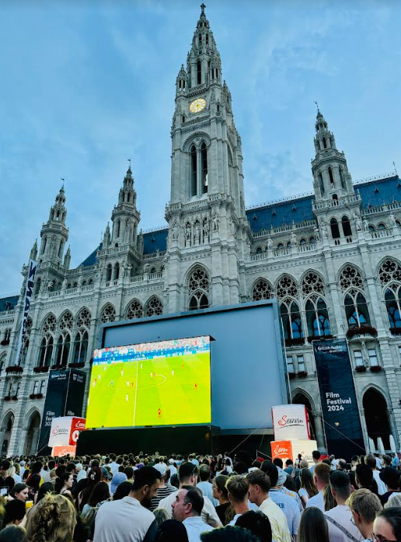


Causality constraints on EFTs
Sera Cremonini
Lehigh University
July 2024

Slide 2
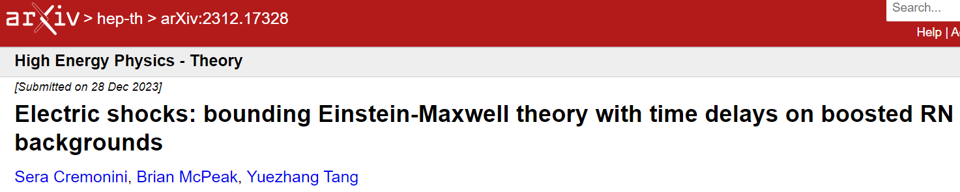
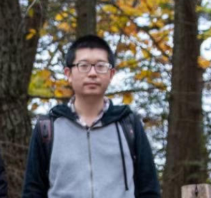
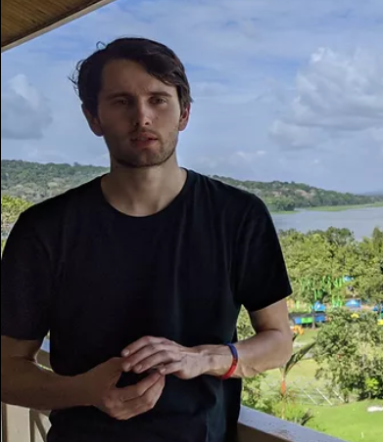
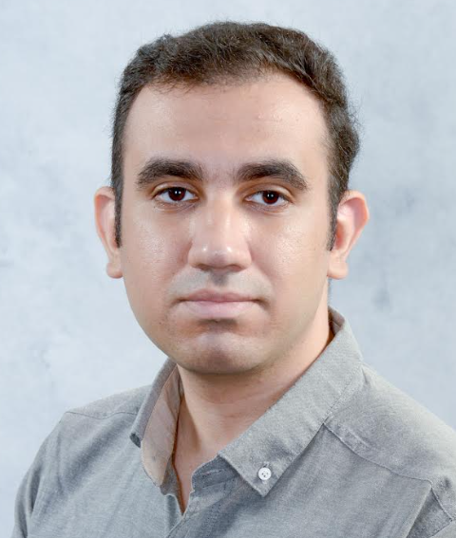
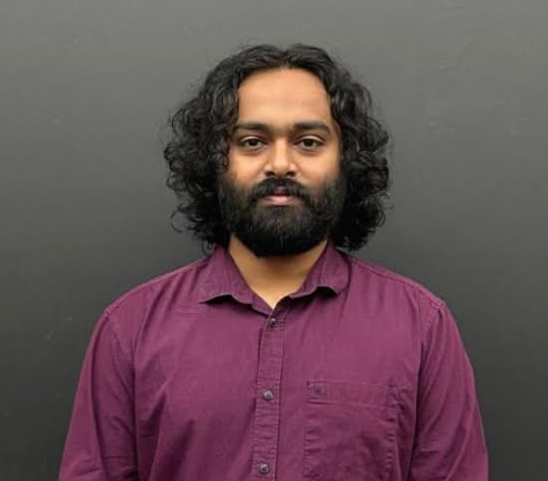
Based on:
2312.17328 with B. McPeak, Y. Tang
work in progress with B. McPeak, M. Moezzi, M. Rajaguru
Our goal:
Examine causality constraints on
the structure of higher derivative corrections to low-energy EFTs,
in the presence of gravity

Slide 3
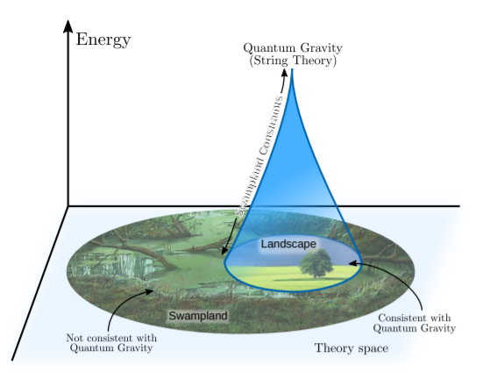
Motivations
Not every consistent EFT can be UV completed in quantum gravity
→ quantum gravity places constraints on low-energy EFTs
Ongoing program to find clear criteria to distinguish the landscape from the swampland and rule out EFTs lacking a UV QM GR completion
Fig. from 2102.01111

Slide 4

Motivations
Not every consistent EFT can be UV completed in quantum gravity
→ quantum gravity places constraints on low-energy EFTs
Ongoing program to find clear criteria to distinguish the landscape from the swampland and rule out EFTs lacking a UV QM GR completion
Many approaches:
  Analyticity, unitarity
  Causality
  Bootstrap program
  Swampland conjectures (WGC,…)
  …
complementary
Fig. from 2102.01111

Slide 5

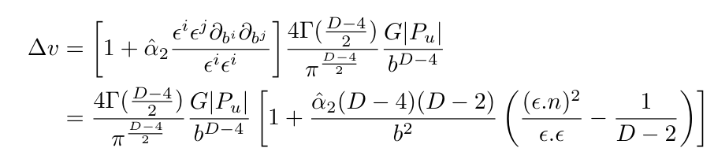
Motivations
Our work: examine causality bounds on four-derivative corrections to Einstein-Maxwell theory, using non-trivial gravity backgrounds:
  How do they compare to pure QFT bounds (on F^4 terms)?
  Generic imprints of gravity?
  What gives most stringent bounds?
  Any connection to WGC or other swampland conjectures?
Inspired by Camanho, Edelstein, Maldacena, Zhiboedov (CEMZ) 1407.5597
Causality constraints on Riem F^2 and Riem^2
Time delay experienced
by (probe) photon going through a gravitational shock wave

Slide 6


Positivity Constraints – pure QFT
Recall Causality, Analyticity and an IR obstruction to UV completion (hep-th/0602178)
Adams, Arkani Hamed, Duboswky, Nicolis, Rattazzi
Certain naively consistent EFTs can’t be embedded in a UV theory with an analytical S-matrix
→ to ensure analyticity in the UV, certain operators must have a positive sign.
Wrong sign of higher derivative operators gives superluminal fluctuations around non-trivial backgrounds (IR breakdown of the EFT)
Purely QFT example
Positivity bounds

Slide 7
Review:
time delays in shock wave approximation

Slide 8

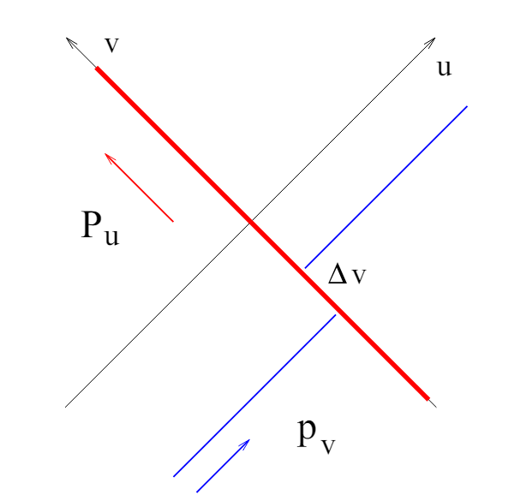

Time Delay in Shock Wave Backgrounds
Shapiro time delay: light going by massive body suffers a time delay relative to motion in flat space
Key point: time advance → causality violation → will use it to constrain EFTs
Time delay in shock wave approximation
Idea:
Ultrarelativistic particle creates a shock wave
(localized at u=0)
Probe particle propagates in this background and
experiences a time delay Δv

Slide 9
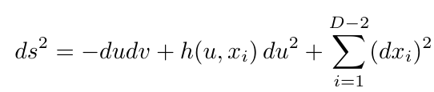

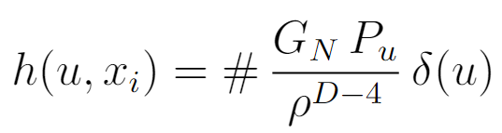
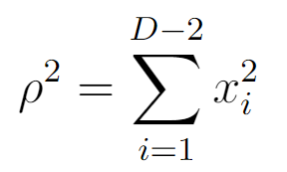
Time Delay in Shock Wave Background
Shapiro time delay: light going by massive body suffers a time delay relative to motion in flat space
Key point: time advance → causality violation → will use it to constrain EFTs
Generic shock wave solution in flat space
GR field of ultrarelativistic particle in flat space
Shock wave profile
Model with stress tensor
For D>4
impact parameter

Slide 10
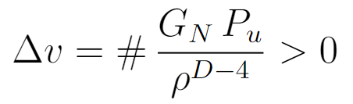
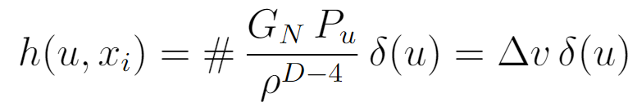
Time Delay in Shock Wave Background
Shapiro time delay: light going by massive body suffers a time delay relative to motion in flat space
Key point: time advance → causality violation → will use it to constrain EFTs
Generic shock wave solution in flat space
Probe particle experiences time delay
simple connection between shock-wave profile
and time delay
(fields minimally coupled to GR)

Slide 11
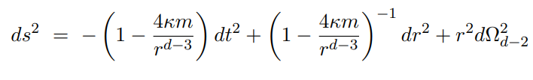
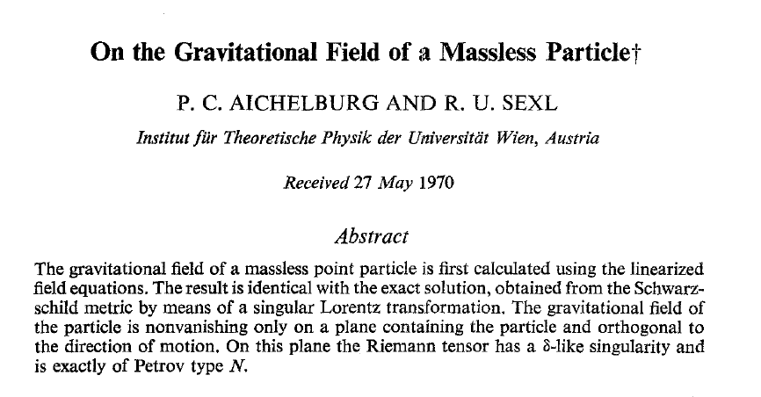
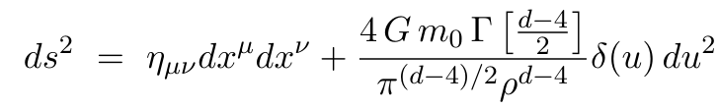


Shock waves from boosting black holes
Can obtain shock wave by taking infinite boost limit of Scwarzschild black hole
Infinite boost
4D → log term
Probe moving in this background will experience time delay
restoring IR cutoff

Slide 12




Time Delay from probe scalar field EOM
Scalar field propagating on shock wave background
Scalar field ansatz:
Again, simple connection between shock-wave profile
and time delay
Extract time delay…

Slide 13

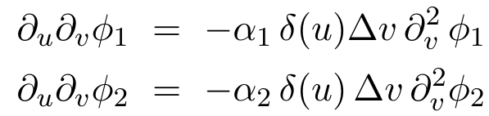
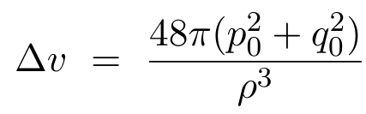

Shock waves in E&M (no gravity as a warm up exercise)
[SC, B. McPeak, Y. Tang, 2312.17328]
4D Maxwell theory with higher derivatives
Background: boosted dyonic charge. Send a photon probe through resulting shock wave
Photon polarizations are generically mixed by the higher derivative interactions (source)
→ choose polarizations so they diagonalize four derivative terms:
Positivity bounds follow immediately

Slide 14
Next:
restore gravity → Einstein-Maxwell theroy

Slide 15

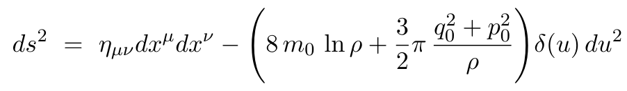
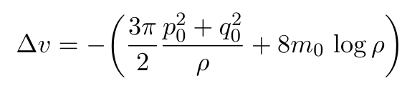





Charged Gravitational Shock-Waves
[SC, B. McPeak, Y. Tang, 2312.17328]
Recall 4D Schwarzschild black hole in infinite boost limit
Log is a feature of 4D
(will lead to IR issues)
Repeat procedure for charged BH → get charged shock wave
Infinitely boosted
RN black hole
Shock wave profile
Simple exercise: compute time delay for a (minimally coupled)
complex charged scalar →

Slide 16


Higher derivative corrections to Einstein-Maxwell
[SC, B. McPeak, Y. Tang, 2312.17328]
Einstein-Maxwell with (perturbatively small) higher derivative corrections
pure QFT case
→ α₁ > 0 and α₂ > 0
Recall CEMZ had studied this term
Logic: compute time delay experienced by probe photon propagating on a CHARGED shock-wave
→ Obtain constraints on Wilson coefficients of EFT
We expect two different effects:
Contribution from the geometry itself (present even at 2-derivative level)
Contribution from higher derivative terms

Slide 17
Higher derivative corrections to Einstein-Maxwell
[SC, B. McPeak, Y. Tang, 2312.17328]
Focus on purely electric case for simplicity (see paper for dyonic case).
Photon EOMs, infinite boost limit:
polarizations
Pol 1
Pol 2

Slide 18





Higher derivative corrections to Einstein-Maxwell
[SC, B. McPeak, Y. Tang, 2312.17328]
Focus on purely electric case for simplicity (see paper for dyonic case).
Photon EOMs, infinite boost limit:
Pol 1
Pol 2
Time delays:
Pol 1
Weyl F^2 term rotates
polarizations
(can’t diagonalize them)
Pol 2
Pure geometry contribution

Slide 19







Main features
Combining all results for both polarizations, schematically:
α₁ and α₂
Electric or magnetic
pure geometry
contribution
higher deriv. terms contribution
When GR decouples one recovers QFT bounds
Gravity weakens the field theory results (generic)
Naively α₁ and α₂ terms dominate at small ρ (can eliminate α₃ ) but you can’t trust the computation arbitrarily close to the source → there is some UV cutoff M →

Slide 20







Main features
Combining all results for both polarizations, schematically:
α₁ and α₂
Electric or magnetic
Because of log, time delay does not vanish at infinity → must introduce IR cutoff to regulate log
Reasonable to require time delay to decrease as you move away from source (standard intuition) :
Doing so and eliminating α₃ dependence (appropriate linear combinations), schematically:
Note weakening
due to GR effects

Slide 21
Main features
Combining all results for both polarizations, schematically:
α₁ and α₂
Electric or magnetic
Because of log, time delay does not vanish at infinity → must introduce IR cutoff to regulate log
Reasonable to require time delay to decrease as you move away from source (standard intuition) :
Bottom line: gravity weakens bounds, and in 4D it’s not obvious how to interpret them

Slide 22

Main features
Compare with CEMZ
polarizations
b: impact
parameter
Correction can become larger than 1 and negative (violating causality) when impact parameter b is sufficiently small
This happens for any choice of α₂, for SOME polarization
α₂ must be small enough that this analysis breaks down
New physics is expected to come in and modify this story

Slide 23
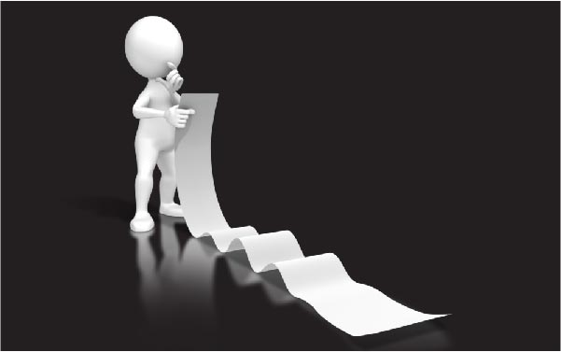
Open Questions
What is the best way to make sense of these bounds in 4D and regulate the log?
How do they compare to amplitude bounds and when are these stronger?
Which backgrounds will give more stringent bounds?
What else can we impose to make these bounds sharper?
What more can we learn in higher D (no log term so cleaner bounds)? Work in progress
Extend/generalize to AdS
…

Slide 24

To Conclude:
Many interesting open questions and avenues
Best strategy → combine all these complementary approaches to build intuition for the role of gravity and develop
a more unified picture of constraints on EFTs

Slide 25
Thank you

